Slide 1
Apex Alliance Club
Additional Club Information

Slide 2
Apex Overview
What is AAC?
AAC mission
Leader Mark Johnson
What is Cryptocurrency and future trading?
Applications used in the AAC project
Free training period and trading signals
How to withdrawal and deposit funds into OP

Slide 3
Apex Alliance Club (AAC)
The Apex Alliance Club is a global investment club based on the futures trading platform, working with Optimus Exchange to help members achieve stable investment returns.
Our goal is to support members in leveraging advanced AI technology and professional analytical teams to use precise market signals for steady profits in the cryptocurrency futures market

Slide 4
AAC Core Mission and Values
Apex Alliance Club (AAC) is an organization dedicated to helping ordinary people achieve financial freedom through financial investment (particularly options trading).
We rely on reliable trading signals provided by a professional market research team to help members earn profits on a stable basis.
AAC is not just a profit-making platform; it is also a force for social change, helping impoverished families and establishing community support networks.

Slide 5
Mark Johnson
Born in London, UK
Graduated from Cass Business School in London with a master’s degree in business administration and financial analysis
Obtained Blockchain Technology Certification Cryptocurrency Investment Analyst Certification
Has 11 years of experience in the cryptocurrency industry
Responsible for leading the team to conduct in-depth analysis of the Bitcoin market including technical, fundamental and market sentiment analysis.

Slide 6
What is Cryptocurrency?
Cryptocurrency contract trading refers to the act of speculating on the price volatility of cryptocurrencies by purchasing futures contracts.
By either going long (buying) or short (selling) on contracts, traders can profit from price movements.
Regardless of whether the market goes up or down, as long as the prediction is accurate there will be profit

Slide 7
Future Trading
Futures trading is an investment method where traders predict the future price movements of an asset (such as cryptocurrency, stocks, etc.) and buy or sell accordingly.
By entering into a futures contract, traders agree to buy or sell the asset at a predetermined price at a specified time, profiting from price fluctuations.
Signals are sent Monday through Friday two times a day 3pm and 8pm (EST TIME)
Saturday and Sunday signals sent at 8PM EST
Adjust the times to your current time zone-example signals sent in PST is 12pm and 5pm
When Trading we put orders in future time- usually 20 mins, but please pay attention to the time on the signal he sends

Slide 8
Applications used in AAC
BonChat (communication)
Optimus Prime (trading)
Coinbase (for withdrawals/deposits)
Crypto.com
Cash app (for withdrawals/deposits)

Slide 9
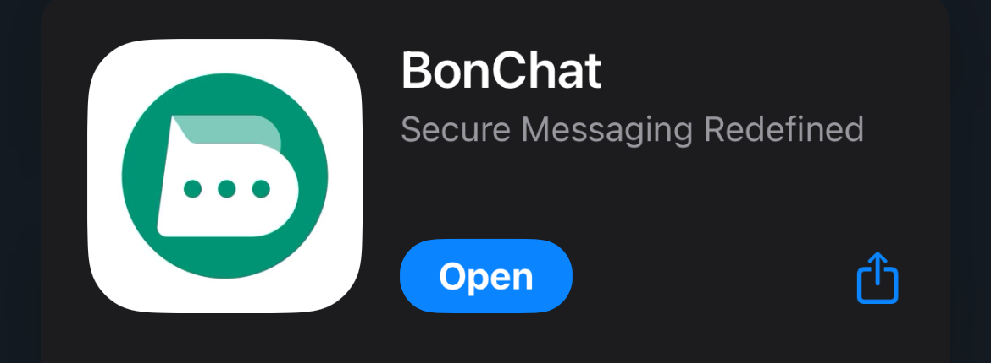
BonChat
Used to communicate between team members
Trading signals are sent through application from Mark
Direct communication with Mark for any issues or questions
Two group chats in Bonchat
Desert Rats (AZ people)
APEX (statewide)

Slide 10
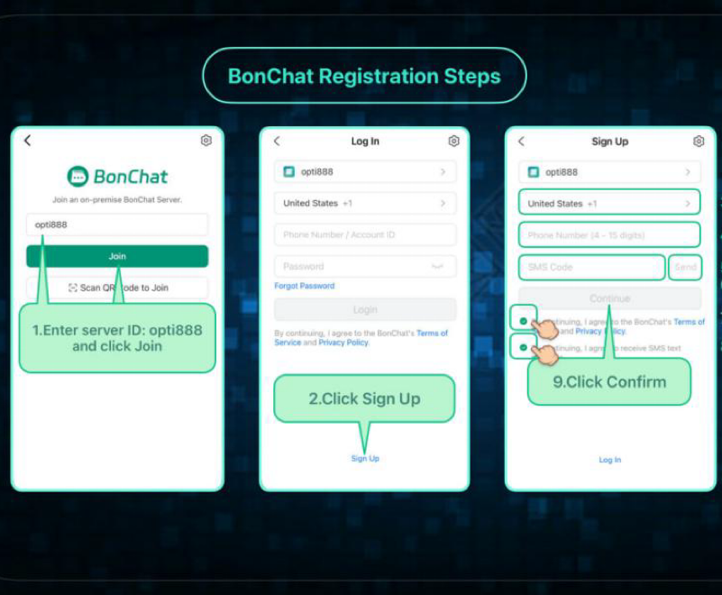
How to Add BonChat
Myself or another member will send you the link to join
Use your mobile number
Server ID is OPTI888
Once logged in, go to the top right corner
click on the top right plus sign (+)
Add Mark Johnson as a friend (AAC38777)
Introduce yourself
He will add you and add you to group chats

Slide 11
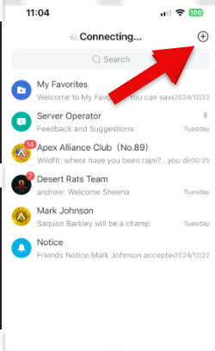
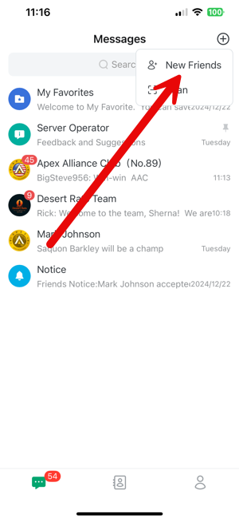
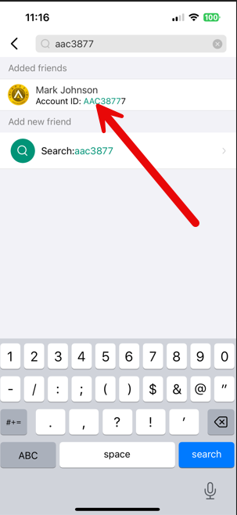
Steps on adding Mark in BonChat
Step 1
Step 2
Step 3

Slide 12
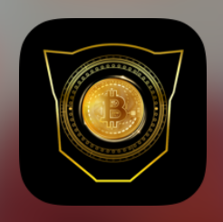
Optimus Prime (OP)
Used for Trading
Receive referral rewards

Slide 13
How to add OP/URL
APP DOWNLOAD optimusprime6.com
URL optimusyo.com
Register new account
Use mobile phone number as log in
Next slide will show screen prints on how to set everything up

Slide 14
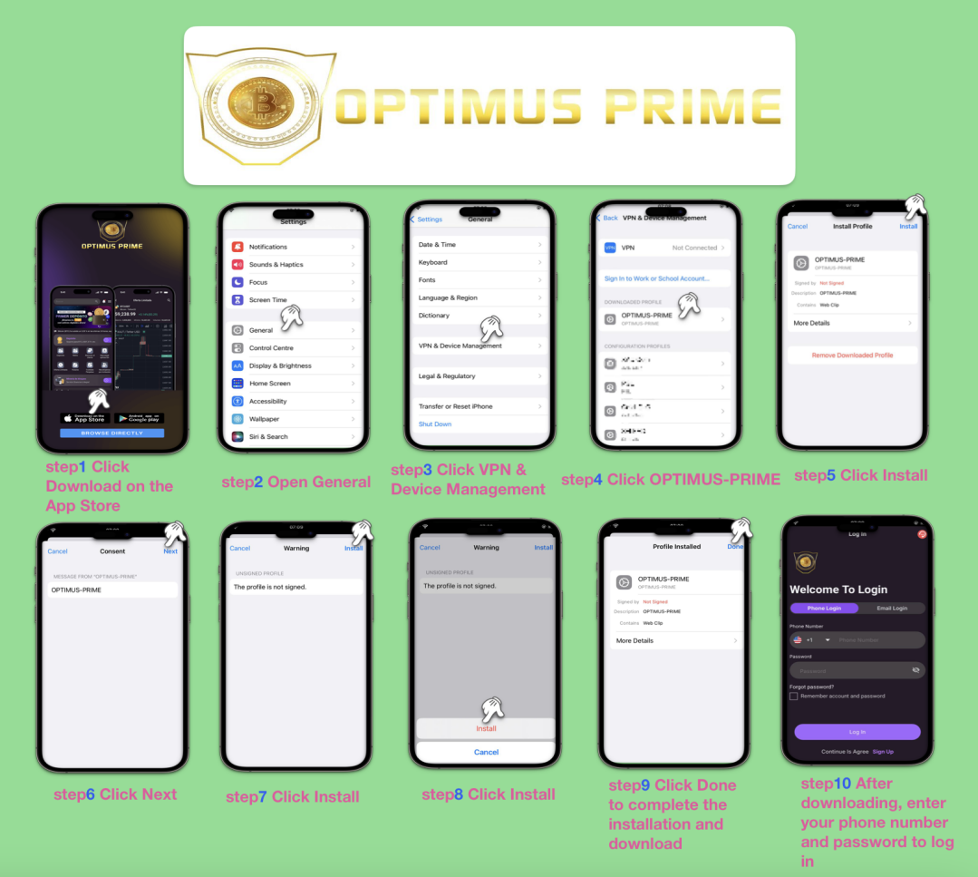

Slide 15
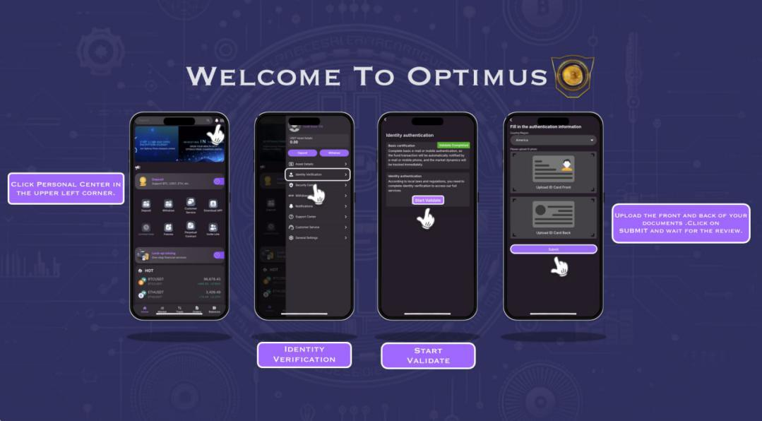
How to authenticate account

Slide 16
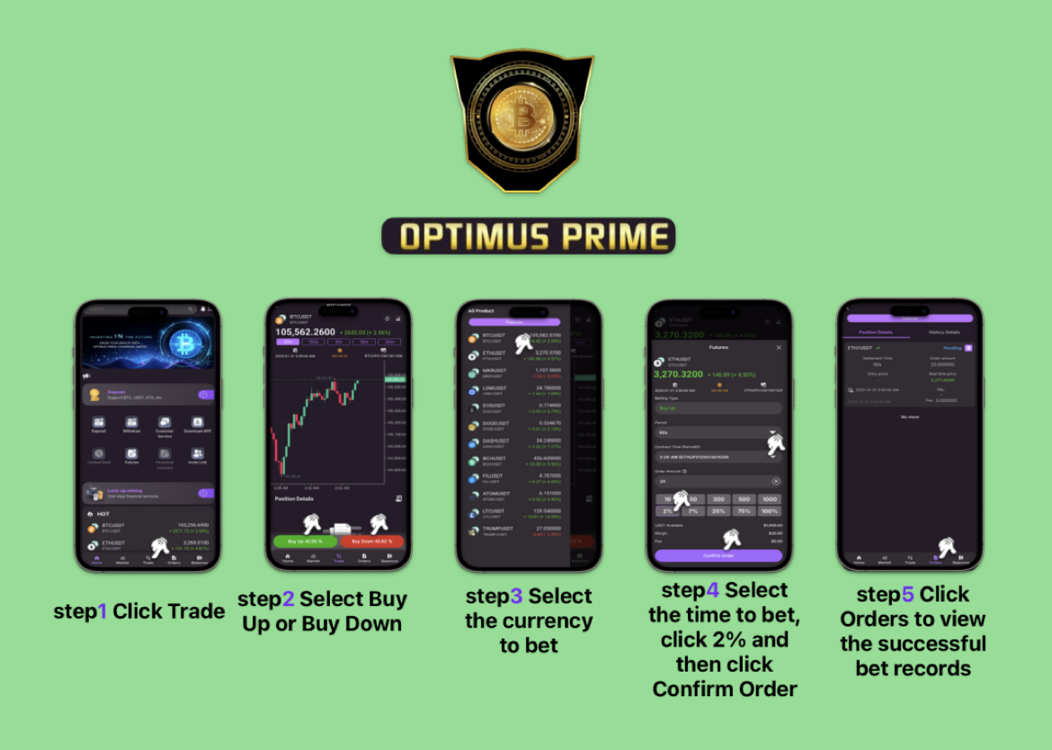
How to future trade with OP

Slide 17
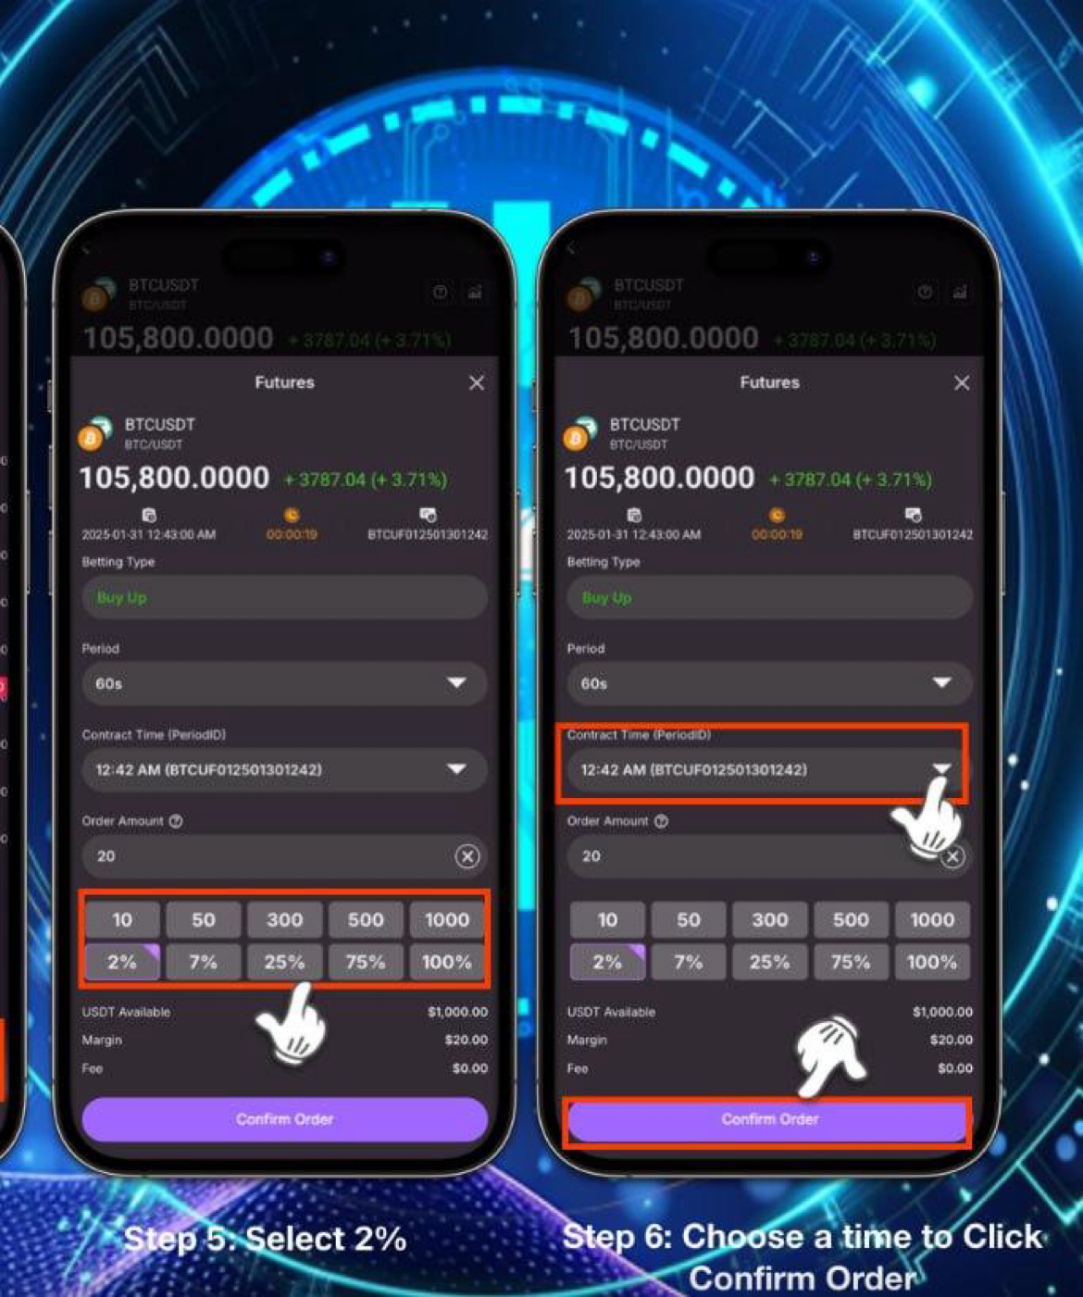
How to future trade continued
You will select the amount to trade with (always 2%)
Then you will select 10 mins after the hour (3pm EST and 8pm EST)

Slide 18
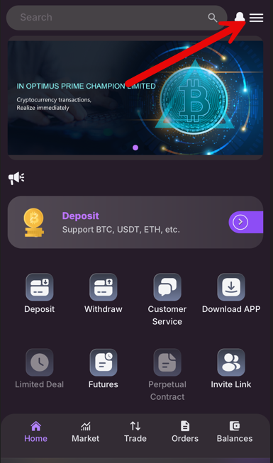
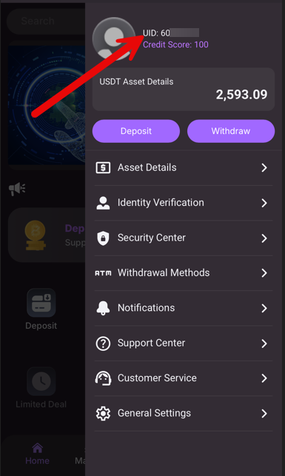
Getting your training funds
Mark will ask for your OP ID (UID)
click 3 horizontal lines
Copy the UID
Send UID to Mark on Bonchat and he will contact platform to have $1,000 deposited.

Slide 19
Trading with AAC
Mark will provide Trading signals everyday
The Apex Alliance Club combines advanced AI technology with a professional market analyst team to provide accurate trading signals.
AAC provide trading signals with up to 95% accuracy. Members can trade based on these signals to generate stable returns.
Use 2% of your account balance (trade) for each trade to ensure stability while managing risk.

Slide 20
AAC training period
Training will last 4 days
Once training is complete Mark will take $1,000 and you keep the money made from trading
Mark makes himself available for questions during training period
Desert Rats group (your state group chat in BonChat) is also available to help

Slide 21
AAC training cont.
To ensure new members are making correct orders they will send Screen shots of their pending order to Mark to make sure order is correct
When trade is complete you will send screen shot of your Historical Order to Mark
This is to ensure everyone profits
If anyone does not profit with the signal provided, Mark will reimburse the loss to ensure we all make profit

Slide 22
Trading Signals
Signals will range from BTC, ETC, LTC and DOGE.
Transaction type will be UP or DOWN
UP (green)
DOWN (red)

Slide 23
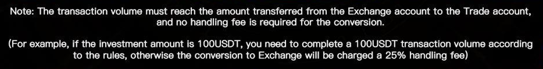
Post Training / Officially joining AAC
Mark will contact the platform to remove the $1000.00 dollars from your exchange
You will keep the profit that was made in those 4 days
If you decide its not for you, you can continue training till you reach your trading volume and can withdraw funds into an encrypted wallet app. (See below)

Slide 24
Joining and referrals
In order for the person who referred you or you refer to the club they would need to make a first deposit of $600, $1,500 or $3,000.
As soon as the deposit is made, The person who referred you will make your welcome announcement!
The next page will show an example announcement and that it looks like for initial deposits of $600 and $1,500.

Slide 25
Win-Win /Commission
A first deposit of $600 will give the recommender $48 and the newcomer $24.
A first deposit of $1,500 will give the recommender $240 and the newcomer $75.
The goal is to get 5 members with either initial deposit in order to start making more money outside of the trades (Weekly Salary)
The referral money goes into your OP balance
If you have any issues you can contact Mark privately to assist.

Slide 26
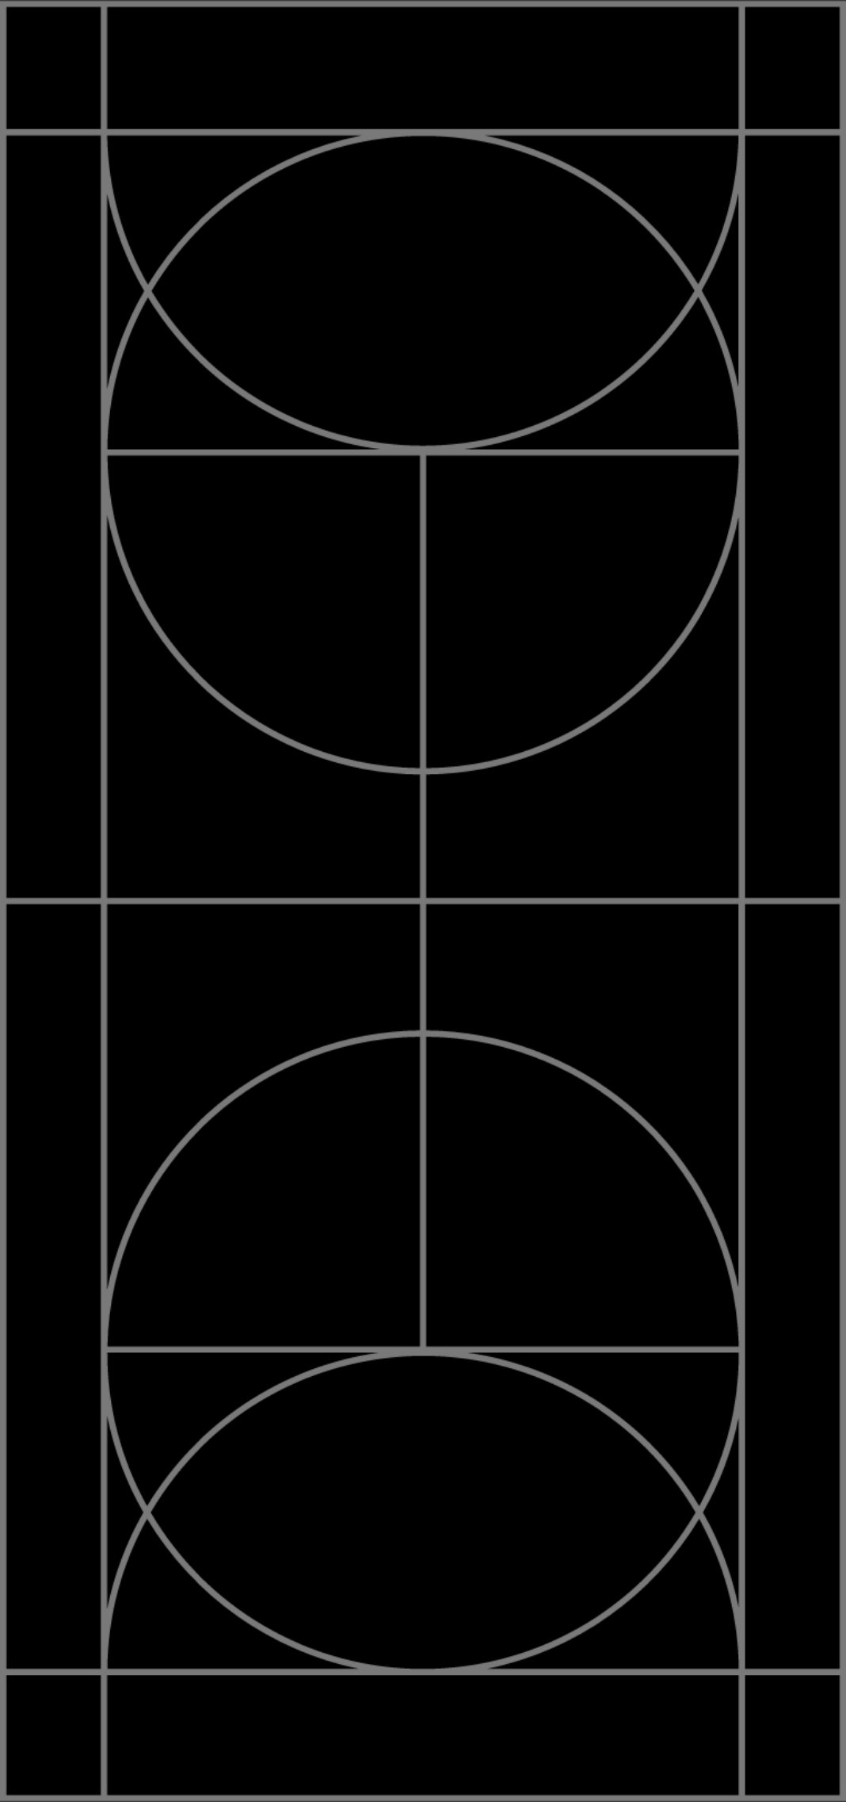
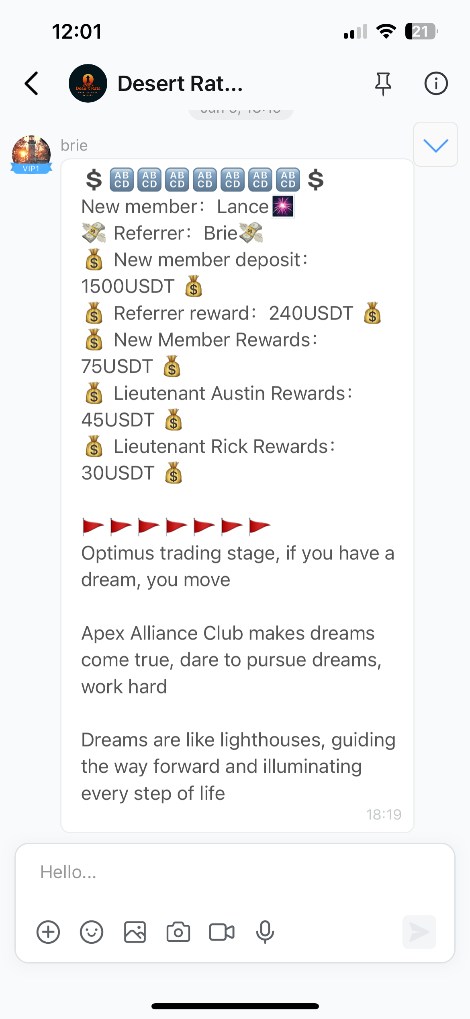
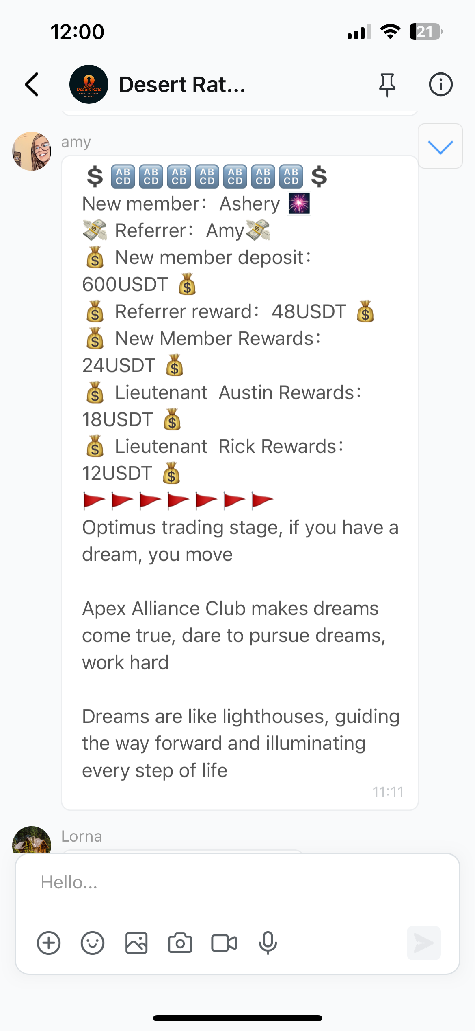
New Club member announcements
This is the formal new member announcements
The referrer and new member will get recognized
You can see the trickle-down effect of rewards for other referrals
Everyone has a chance to increase their ranking level
Which is why I emphasize on getting 5 members under you and ranking will come

Slide 27
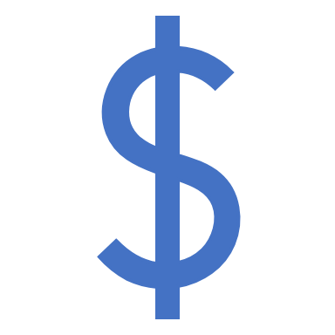
Getting weekly salary
When you get 5 members to officially join you will get a weekly salary
Its important to help those members with any questions and assist in expanding “your team”
The bigger your team, the bigger your potential weekly salary

Slide 28
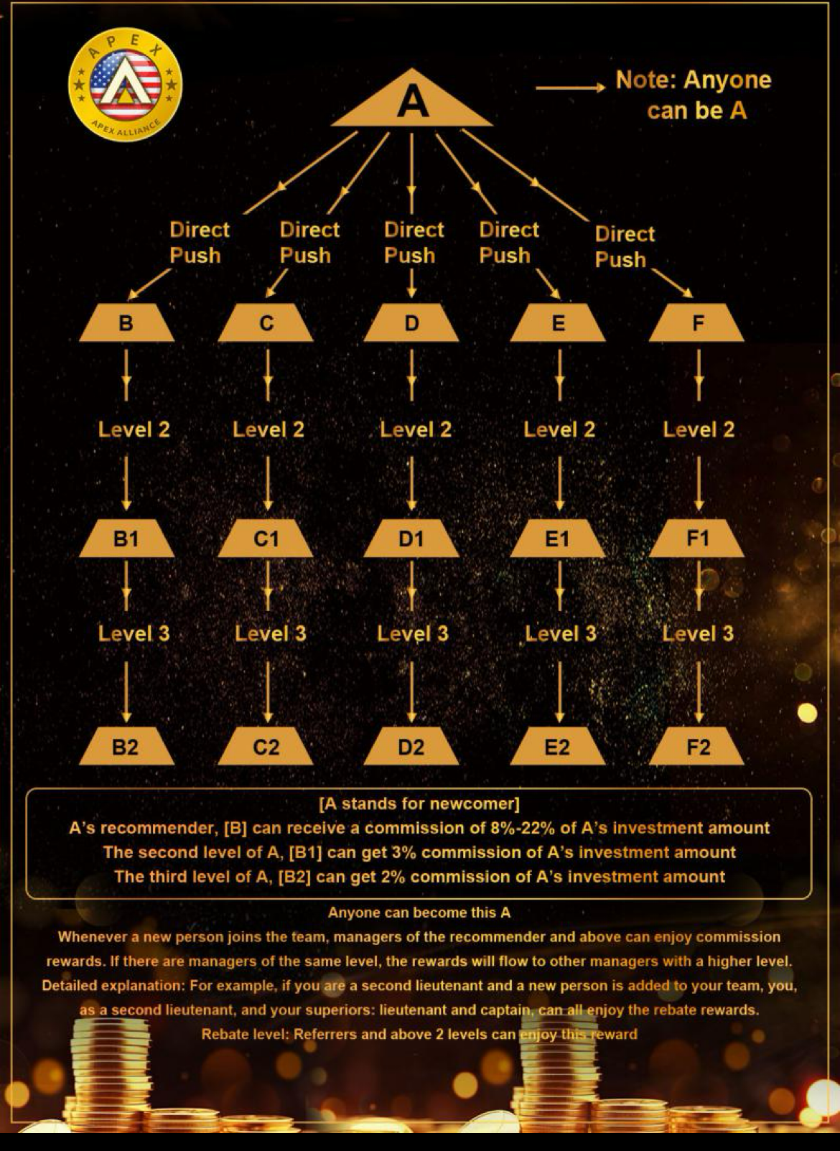
Diagram of a team
We all start out as A
Focus on getting 5 people
Assist in B, C D, E, F new members to form their team of 5 and then they Become A
B, C, D, E and F’s members count towards the original A
We are creating a family tree with a common goal towards financial freedom

Slide 29
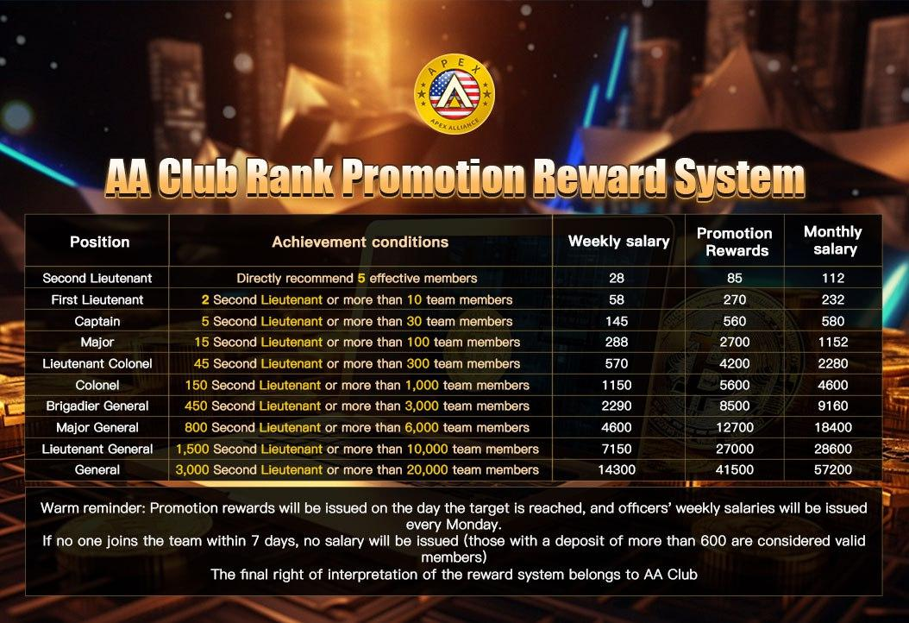
Officer ranking and their weekly salary
When you manage a great team we are all successful and have the chance to increase our weekly salary
The move volume and people that use OP, the more money OP makes
The more money OP makes, the more money we make

Slide 30
Withdrawing funds from OP
Must go through the verification process in OP- your referral should do this with you right away
Must reach your trade volume prior to making any withdraw (the app wont let you until you do)
Withdraws from OP take 48 hours (excluding weekends) to get to your digital wallet
We have some useful videos in Bonchat to help with the withdraw process
Your direct referral will aid you in educating the process to ensure you get your funds to your bank successfully

Slide 31
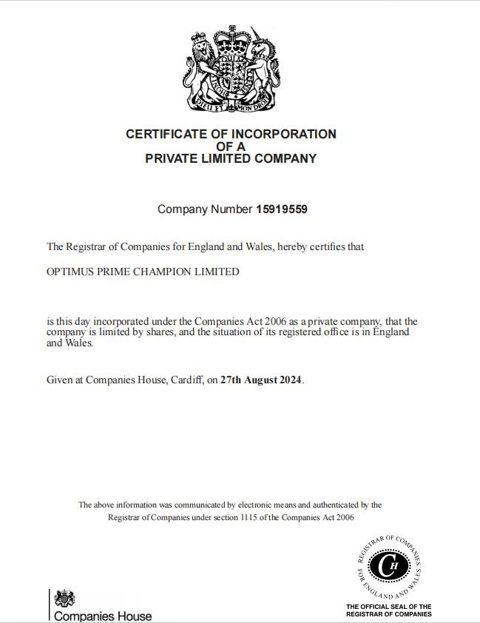
License of Optimus Prime

Slide 32
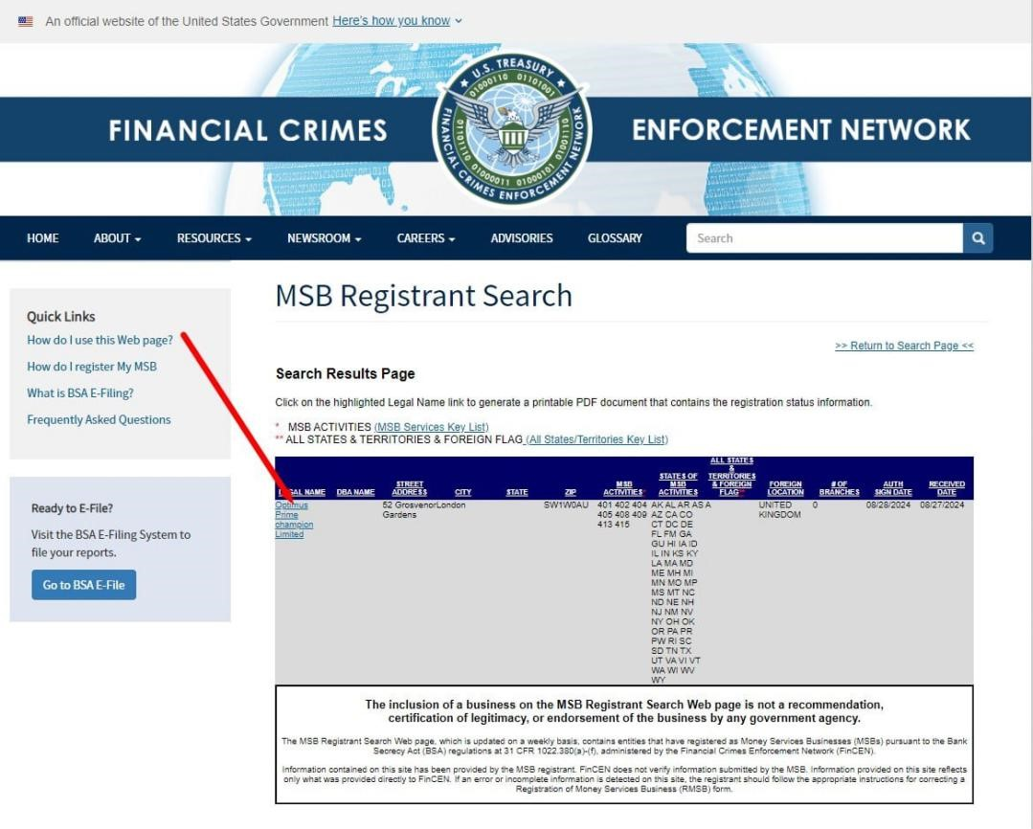
Registration of Optimus Prime in U.S

Slide 33
Taxes
Platforms such a coinbase have 1099 forms to fill out.
always consult your tax accountant to get more information depending on your own financial situation

Slide 34
Links for adding OP and Bonchat
Bonchat server ID: opti888 Mark's Bonchat account: AAC38777 Bonchat download link: Android: https://play.google.com/store/apps/details?id=com.cipherchat.bonchat Apple: https://apps.apple.com/us/app/bonchat/id6701998686?l=enhttps://apps.apple.com/us/app/bonchat/id6701998686?l=en https://optimuw.comhttps://optimuw.com
optimucl.com
optimucn.com
optimucx.com

